Slide 1

“Gabbies” on Streets :
Data Analysis on Street Price of Gabapentin
Group 5: Yunran Chen, Lingxi Song, Siqi Fu

Slide 2
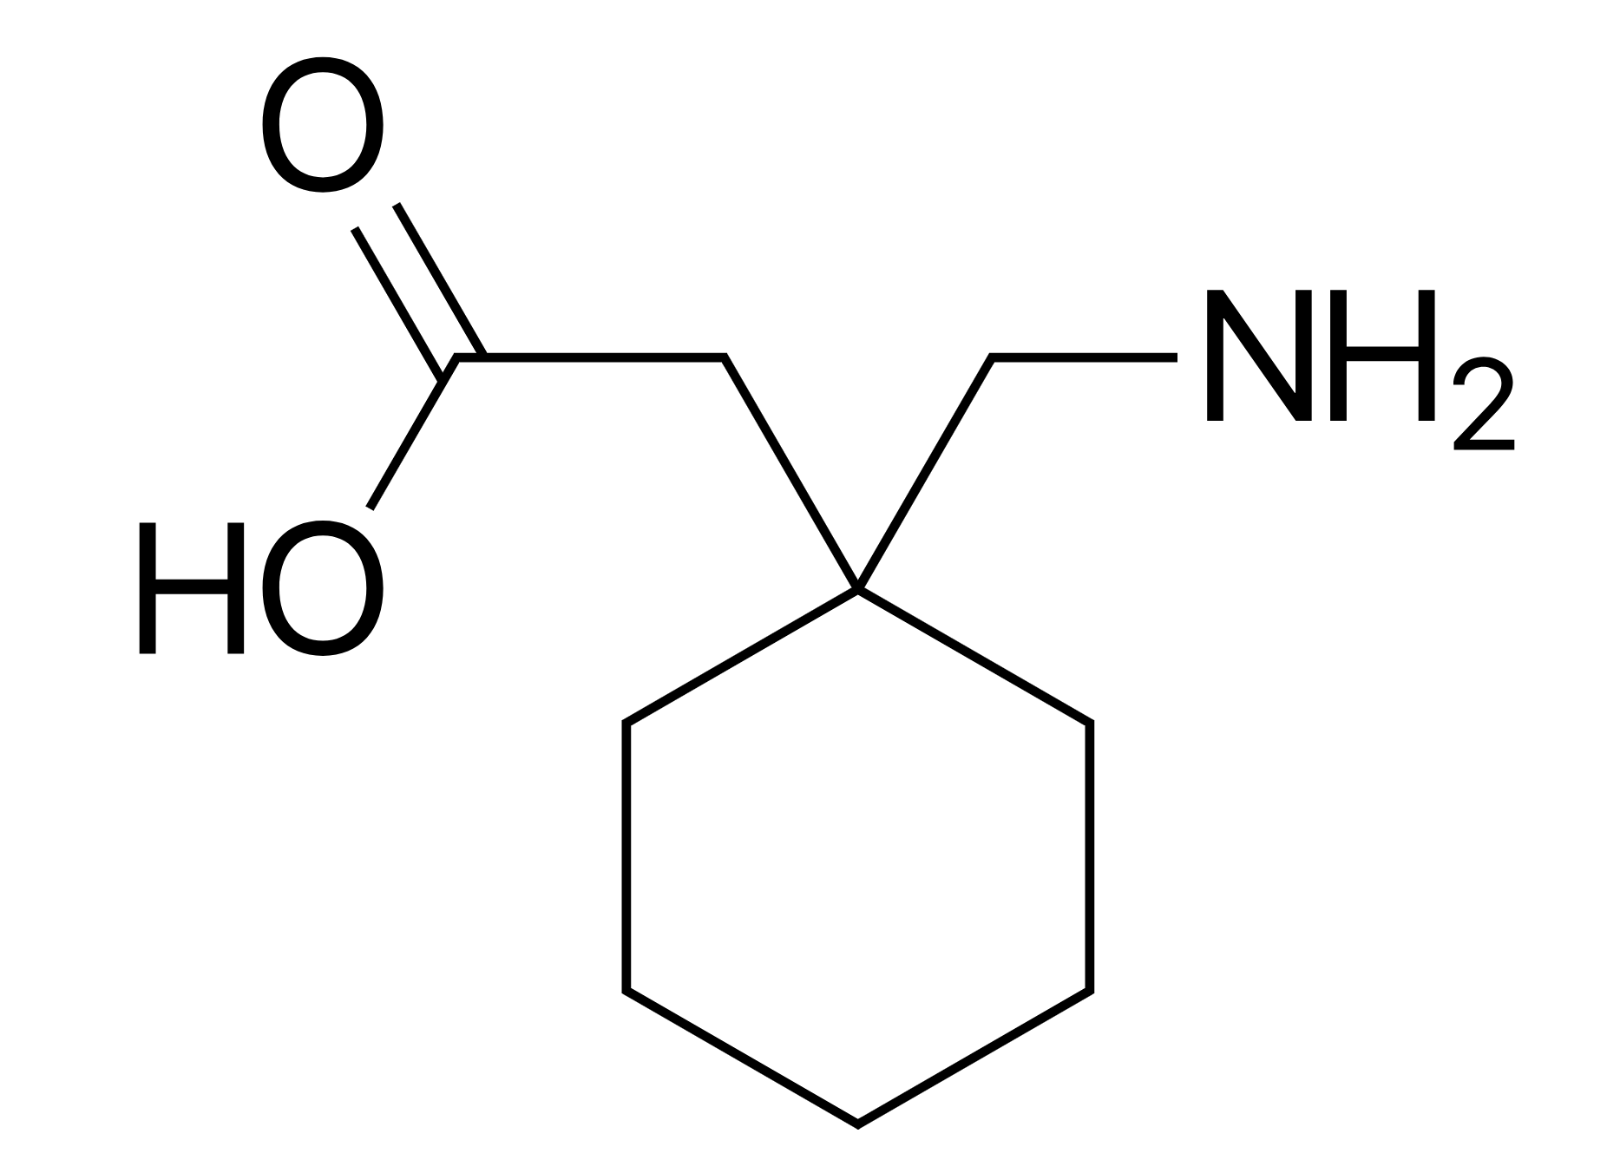
Introduction: Gabapentin
is used to treat certain types of seizures and nerve pain.
is first approved for use by FDA in 1993 .
has been approved as a generic medication in the USA on September 23th, 2014.
is cheap, and ranked 4th popular prescribed medication in USA
Has euphoric effects -- being abused for getting high

Slide 3
Introduction: Gabapentin
is used to treat certain types of seizures and nerve pain.
is first approved for use by FDA in 1993 .
has been approved as a generic medication in the USA on September 23th, 2014. -- I(policy)
is ranked 4th popular prescribed medication in USA -- stable price
Has euphoric effects -- being abused for getting high -- data preparation

Slide 4
Goal: what influence the price ?
Dataset: StreetRx
Which factors have potential effect (source, reason, bulk, dosage strength)?
Whether there are regional variance? (city, state, USA region)
Whether there is a trend over time or seasonal effect? (date, quarter of purchase)
Whether a policy takes effects?
Where can I buy the cheapest Gabbies (Rank states by the price)?
1578 self-reported street price (per mg) records by anonymous users from 2013/02/16 to 2019/3/30 in the United States

Slide 5
Data preparation
Missing value
Exclude “city” since it contains 40% missing value and provides similar info as state.
Imputed “Not specified” for NA in `Source`.
Imputed “Not answered” for NA in `Primary Reason`.
Unreasonable Records
Exclude records with PPM <= 0
Exclude records with `Primary Reason` as “calm down”.
Transformation
Apply logarithm to PPM, denote as “logppm”.
Combine Categories
Combined "Usatoday.com", "Reddit.com" ,"Reddit", "Quora" records in the `Source` column into "Internet" since they are similar.

Slide 6
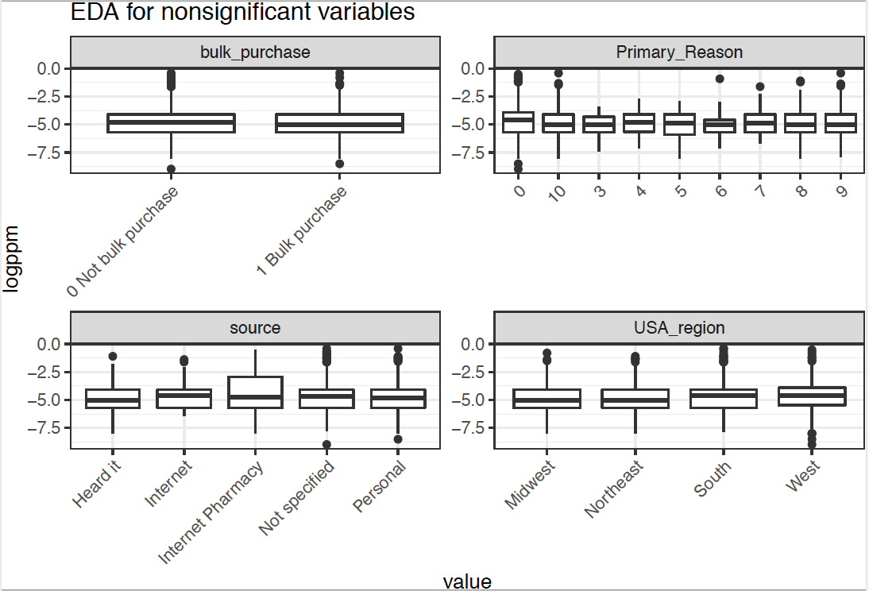
EDA: factors without significant influence
Bulk purchase,
reason of purchase,
source,
USA region
do not have significant effect on price.

Slide 7
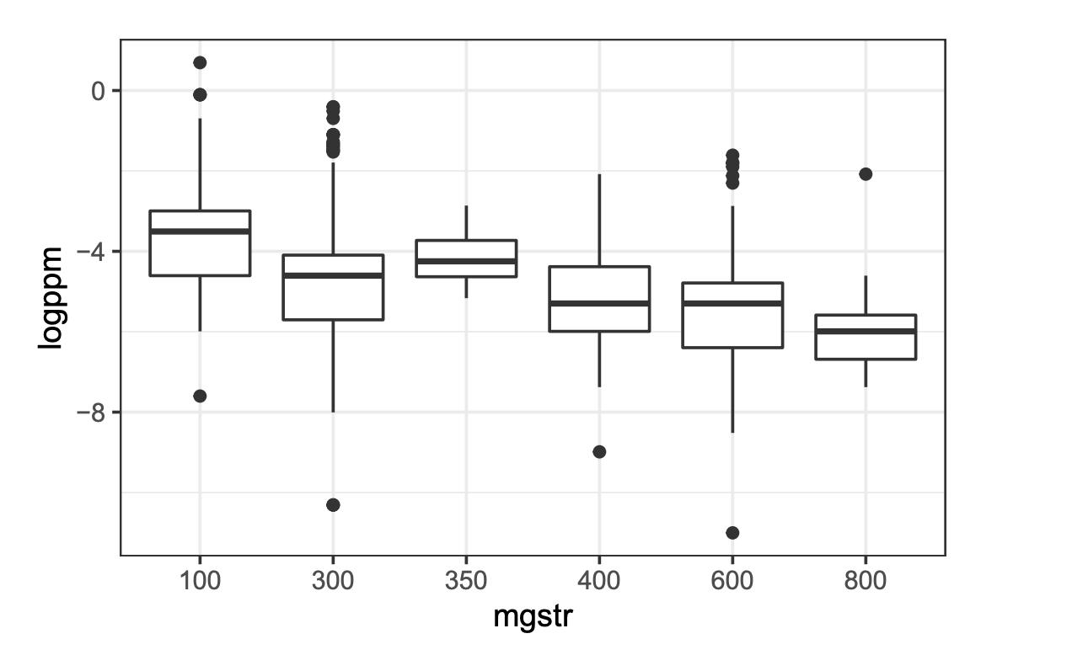
EDA: dosage strength has significant influence
The dosage strength in mg of the units
has a nonlinear effect (-log).
Notes:
The dosage strength in mg of the units purchased seems to pose a nonlinear effect on the price (see Figure 4). As the dosage strength increase (except for 350 point), the price decrease and the decrease rate slower down.

Slide 8
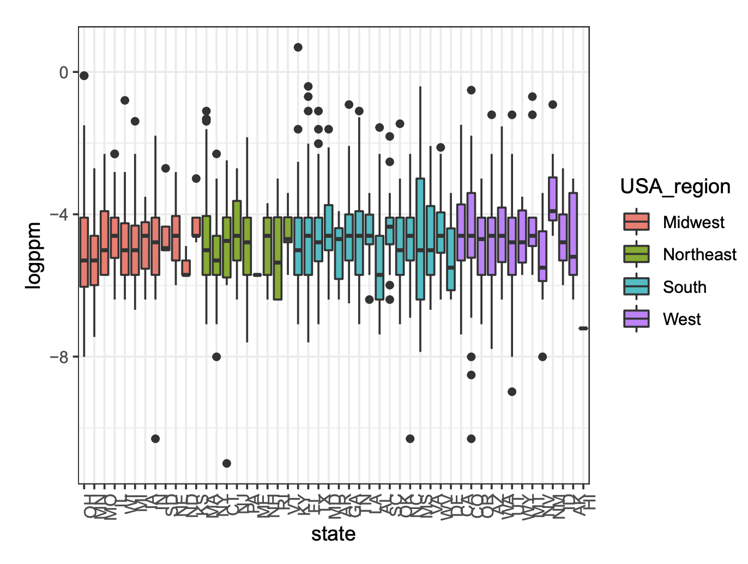
EDA: Regional heterogeneity exists
Heterogeneity across states
exists.
Notes:
Figure 2 suggests there is a heterogeneity across states, but there seems no heterogeneity across four USA regions.

Slide 9
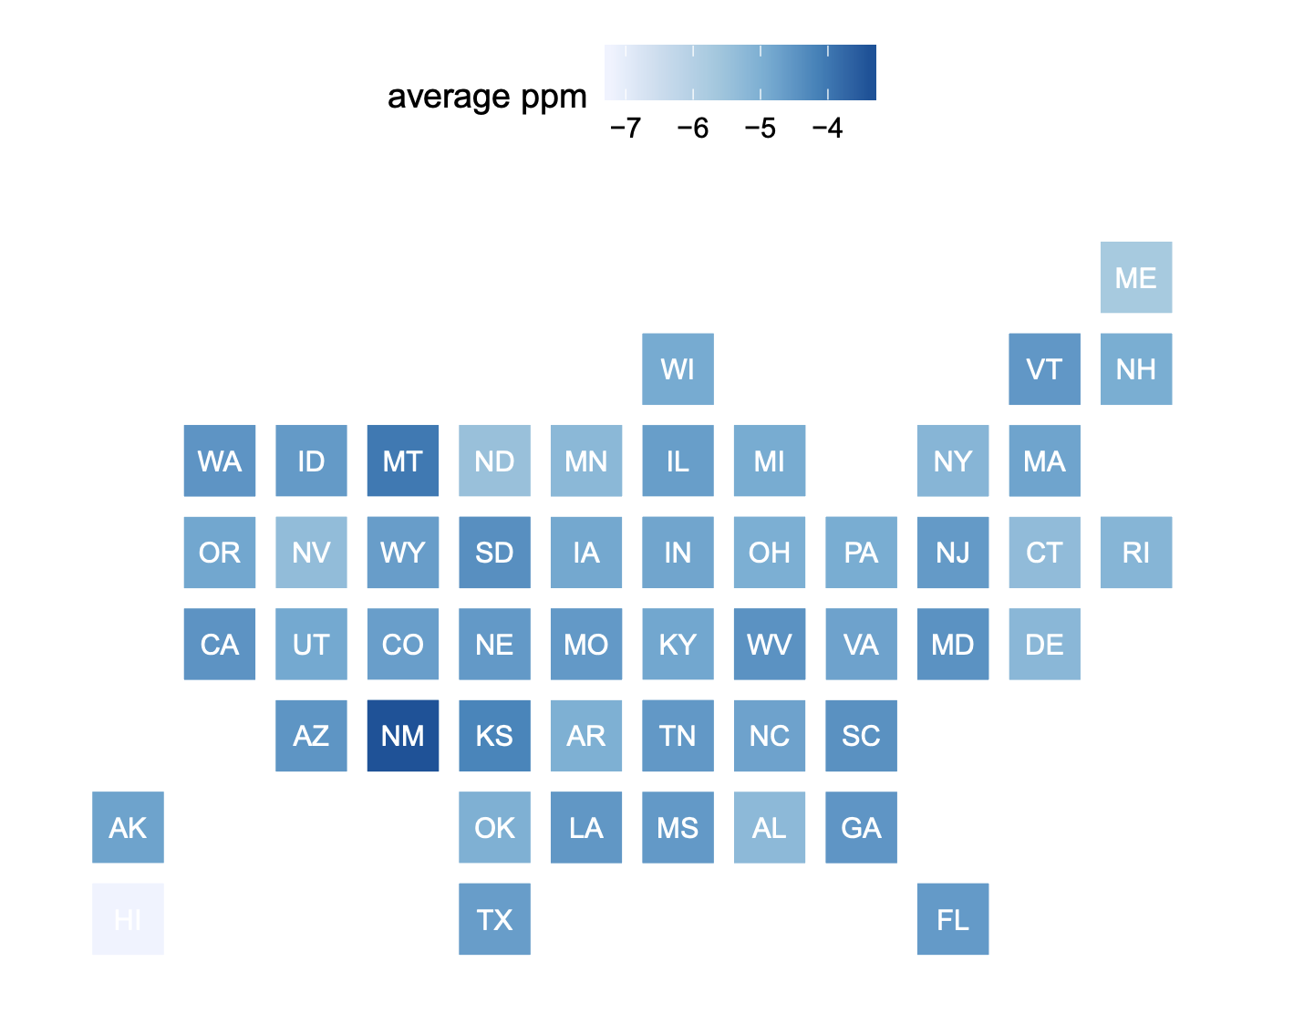
EDA: Regional heterogeneity exists
No significant connection among states geographically

Slide 10
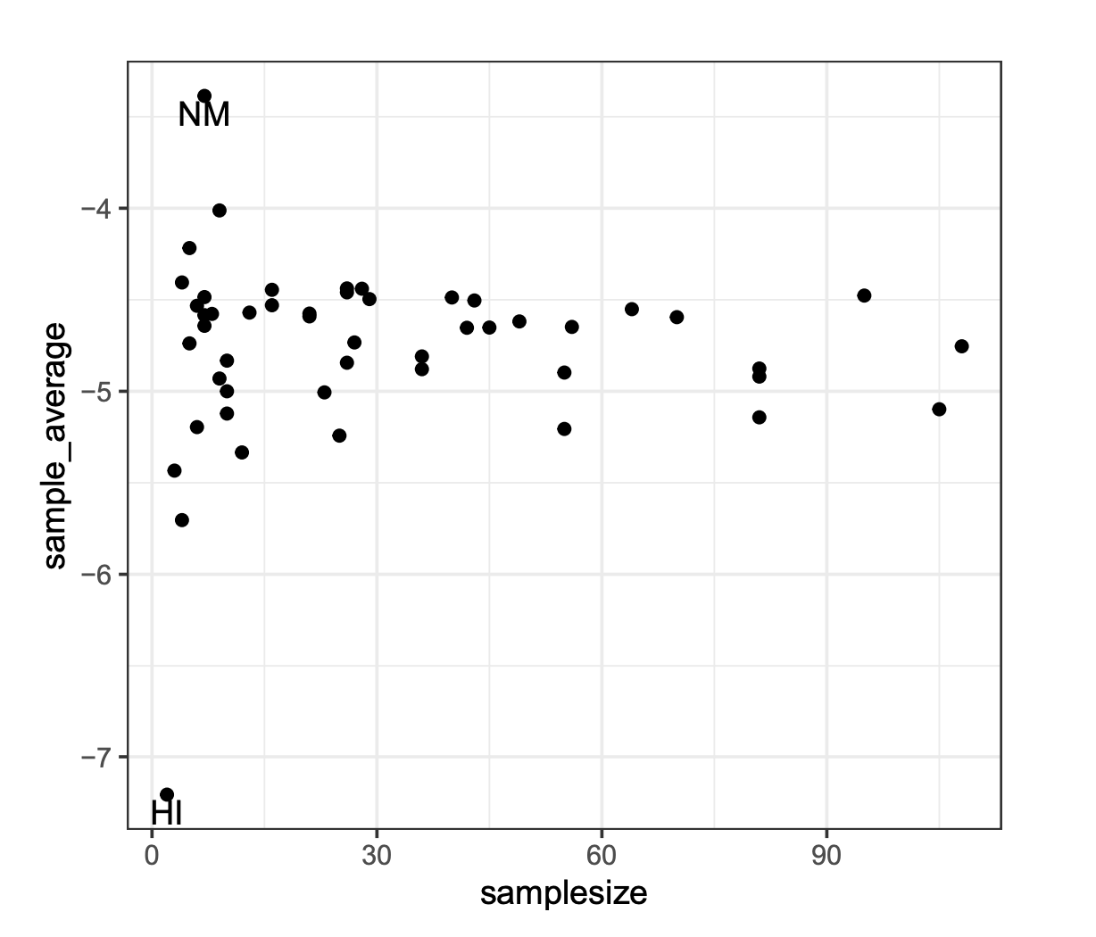
EDA: Regional heterogeneity exists
EDA: Sample Size versus Average logppm per State
Less sample size tends to have larger variance.
-- Hierarchical structure needed
Notes:
Figure 5 suggests states with less sample size tends to have larger variance, indicating a hierarchical model is needed to allow for borrowing information across states.

Slide 11
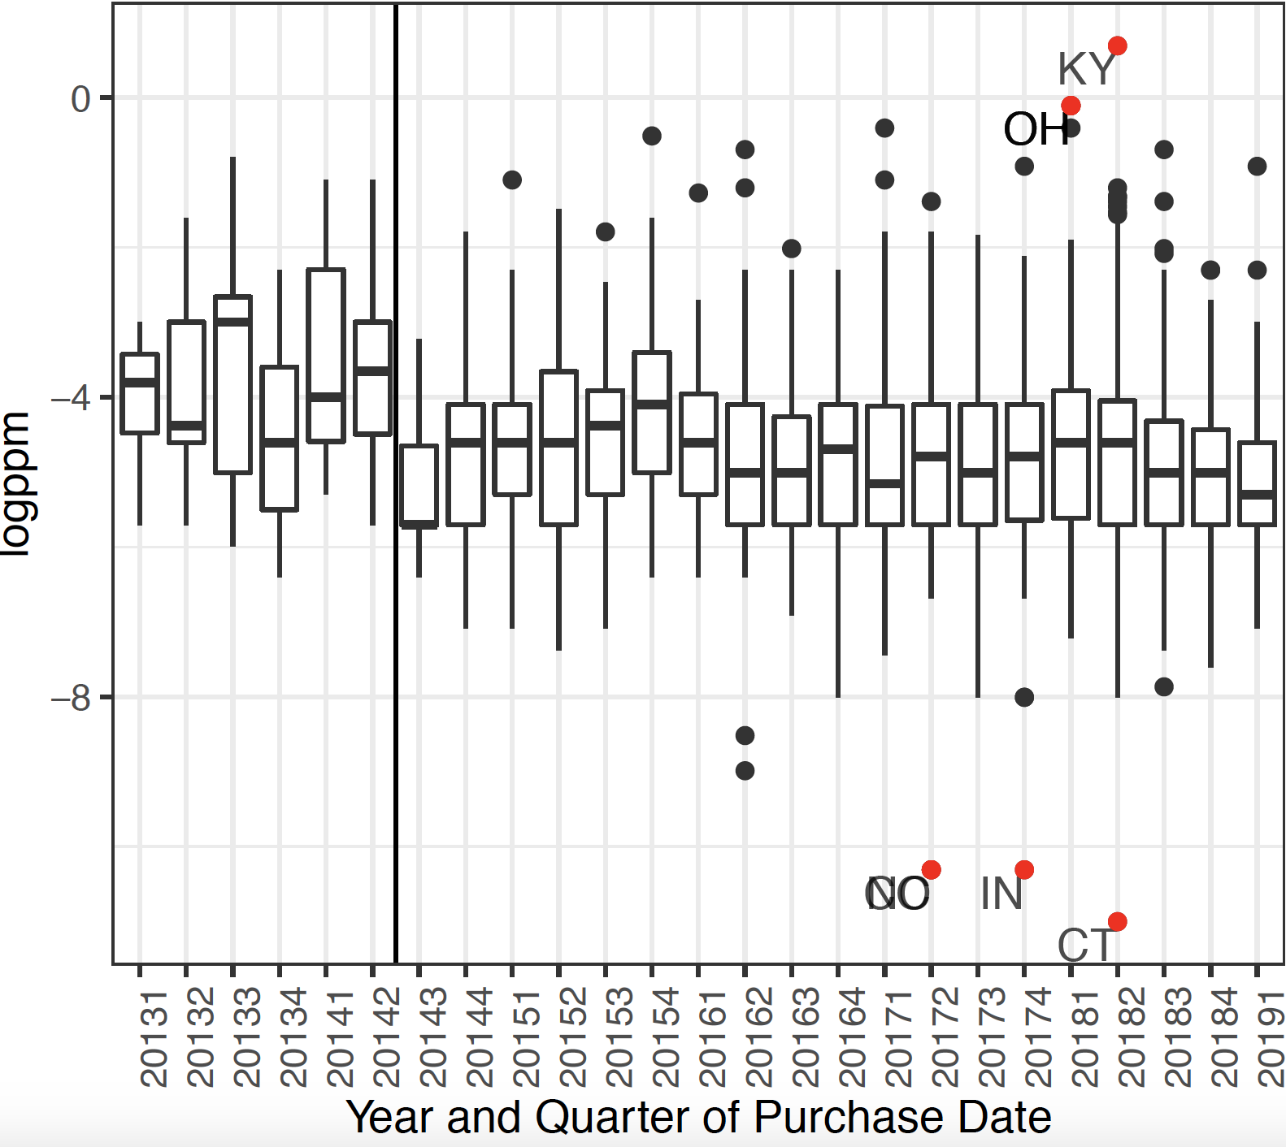
EDA: The policy took effects
Relatively stable over time
A significant drop of price in 2014 Q3 (Policy)
Notes:
The third quarter of 2014 acts as a special time point. A significant drop of price happens in this quarter, and the price remains relatively stable at a relative lower level since then.
No significant seasonal effect is shown. We marked 7 outliers (3.5 standard deviation from the mean) which do not show some special patterns with respect to state and other predictors.

Slide 12
Modeling Process
Base model: I(policy) + log(dosage strength) + (1|state)
Incorporate time effect:
Date, quarter or I(policy)
Continuous vs categorical
For continuous: polynomial, spline, log, …
In corporate dosage strength:
Continuous (polynomial, spline, log, … ) vs categorical
Full model: whether to incorporate other factors
Pre-final model: whether to include interaction or consider other random effects
Criterion: BIC, LRT

Slide 13
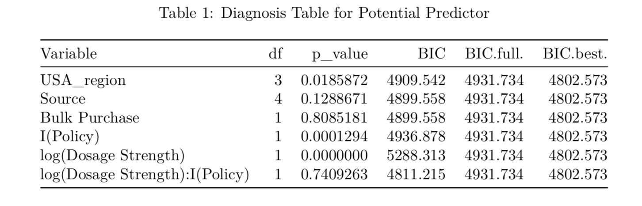
Results
Consider 0.005 threshold.
Notes:
Table 1 shows the result of the LRT and BIC. Based on the testing result, we conclude that other predictors except for the dosage strength and policy do not bring significant effect nor improve the fitting performance of model.

Slide 14
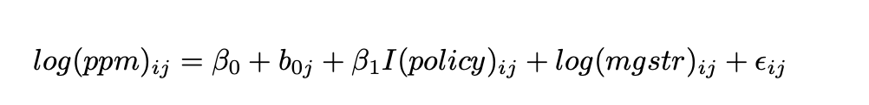


Final Model
j: state i: individual

Slide 15
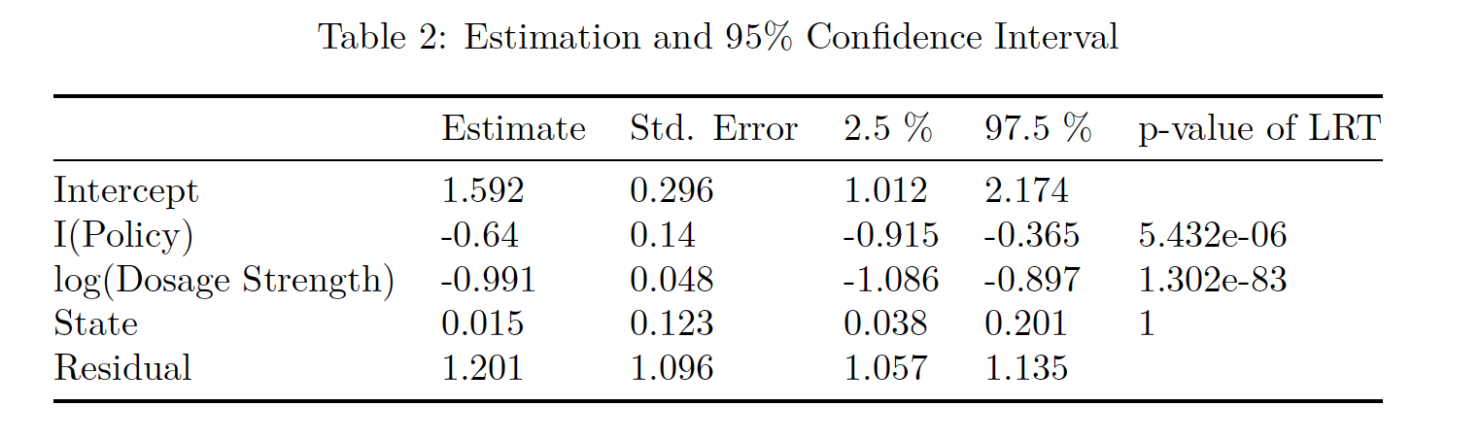
Results
*
*
After Gabbies become a generic medication, the price decreases by around 30.5% to 59.9%.
Increasing the dosage strength in mg per unit by 10% will decrease the price by 8.2% to 9.8%.
No significant heterogeneity across states.
No significant effects from other factors.
Notes:
Table 2 shows the estimations of our model parameters. Holding other factors consistent, the policy, which
considering Gabapentin as a generic medicine, leads to a drop of the price. Specifically, we are 95% confident
that after the policy takes effect nationwide, the price is expected to decrease by around 30.5% to 59.9%.
Increasing the dosage strength in mg per unit by 10% will expect to decrease the price by 8.2% to 9.8%. It
may because that as the dosage strength in mg increase, the size of tablet will decrease, which will decrease
the cost of production which leading to the decrease of price.
Additionally, we found that there is heterogeneity across different states. We are 95% confident that the
variance of logarithm of price among different states are around 0.038 to 0.201. But there are no significant
heterogeneity across states.

Slide 16
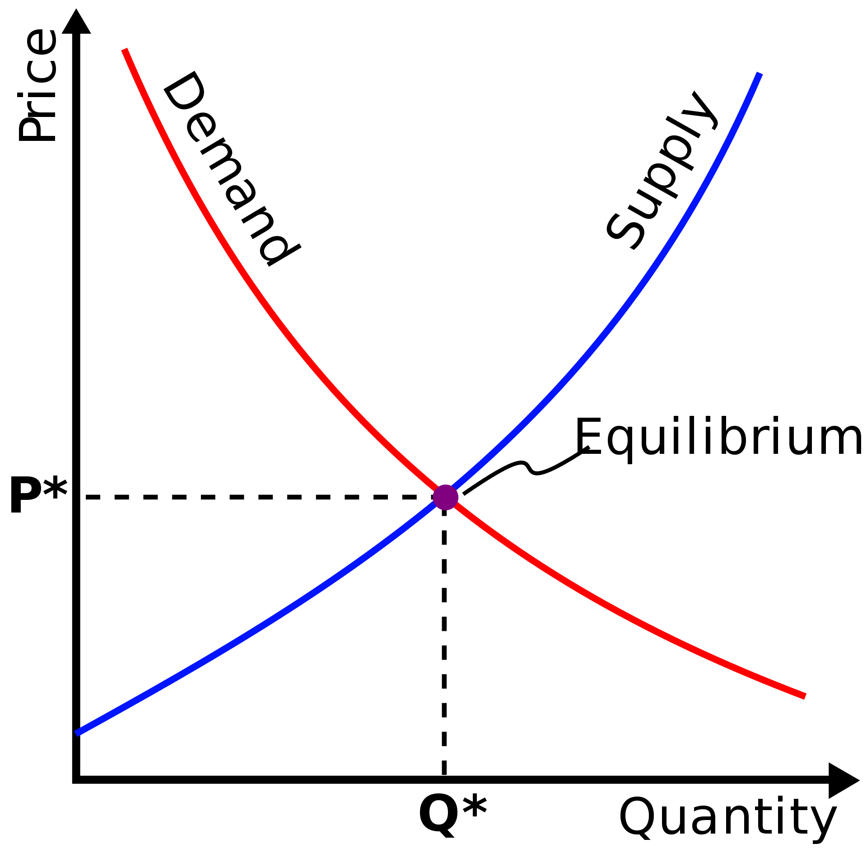
Interpretation
From Market:
Generic and Nationwide Medication -> Sufficient Supply :
Sufficient Supply → Decrease its price
Nationwide Medication → No heterogeneity across states;
No heterogeneity effect across states
Sufficient Supply, Cheap, Popular → Relative Stable:
Sufficient Supply: No significant trend over time, across regions
Cheap: not influenced significantly by the demand
(purchase reason or bulk purchase)
Popular: No need to lie (source of information)
From Producer:
Increase dosage strength in mg per unit → Decrease Cost → Decrease Price

Slide 17
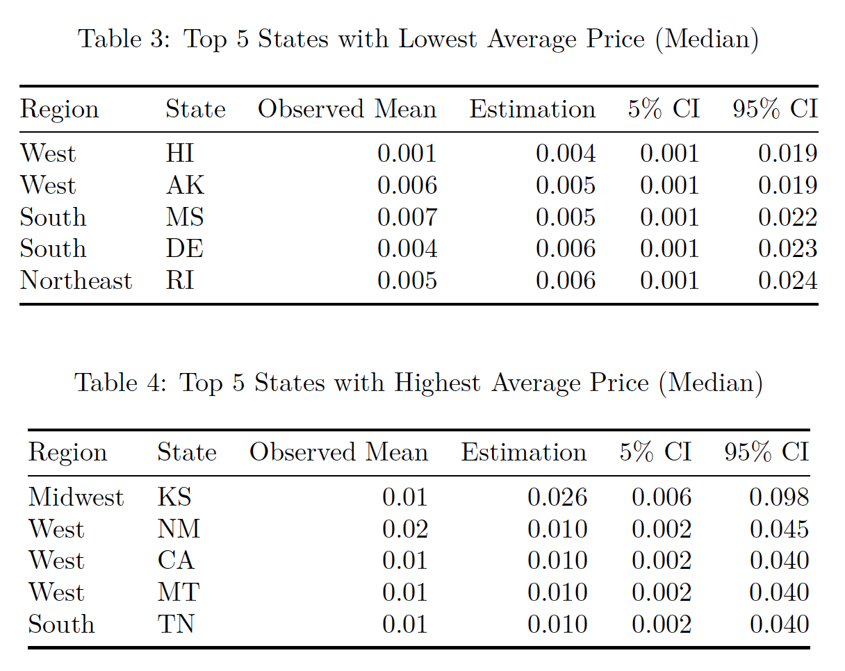
State Ranking
Notes:
We further applied our model to rank states based on the price controlling the policy and dosage effect. Table 3 and Table 4 that have the highest price per mg, and the lowest price per mg. Based on our prediction, Hawaii has the lowest price per mg, and Kansas State has the lowest price per mg.

Slide 18
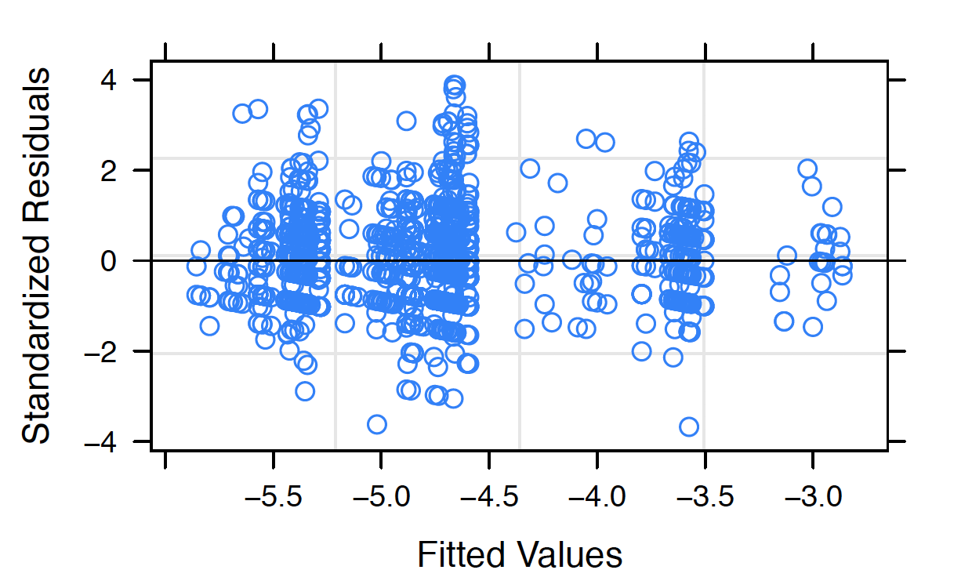
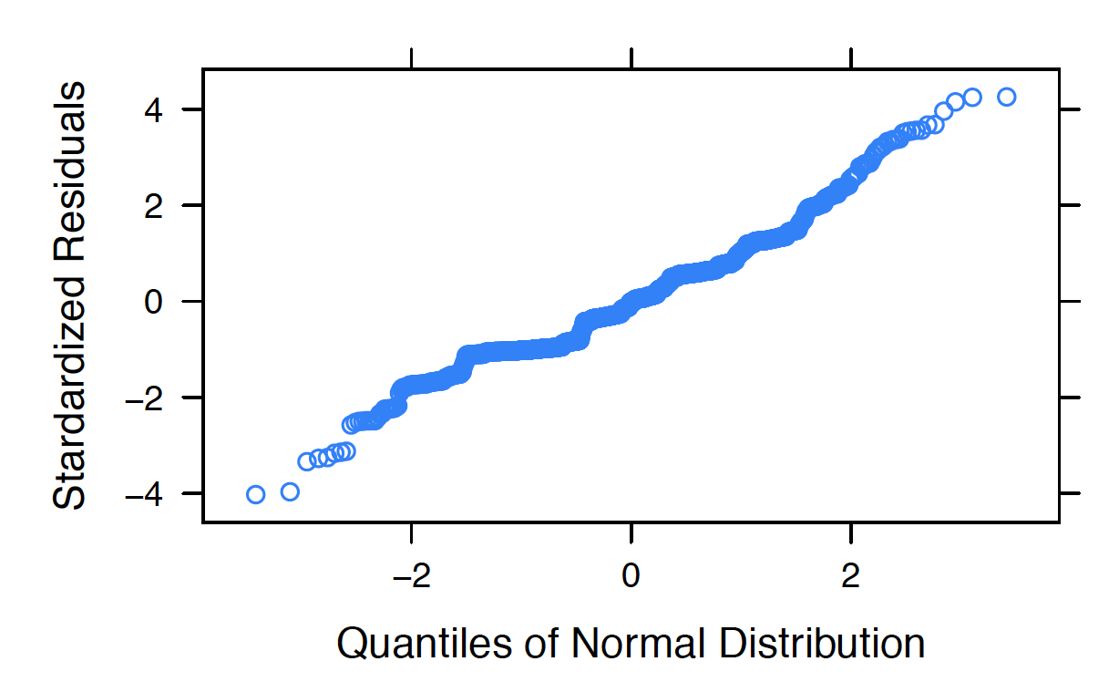
Model Diagnosis
Notes:
During the model comparison with other alternatives, our model has the lowest BIC, and each terms we
included are statistically significant (p-value less than 0.005)7 . From the residual plot (Figure 6), we found
that all the residuals are normally distributed around zero. From the qqplot as shown in Figure 7, the overall
residuals satisfy the normal assumption and only several points at the tail are slightly violate the normal
assumption.

Slide 19
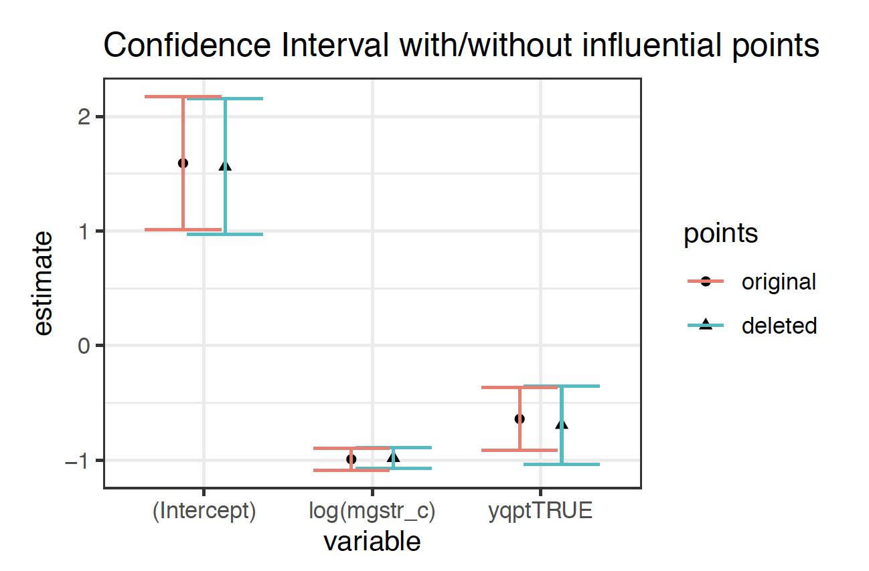
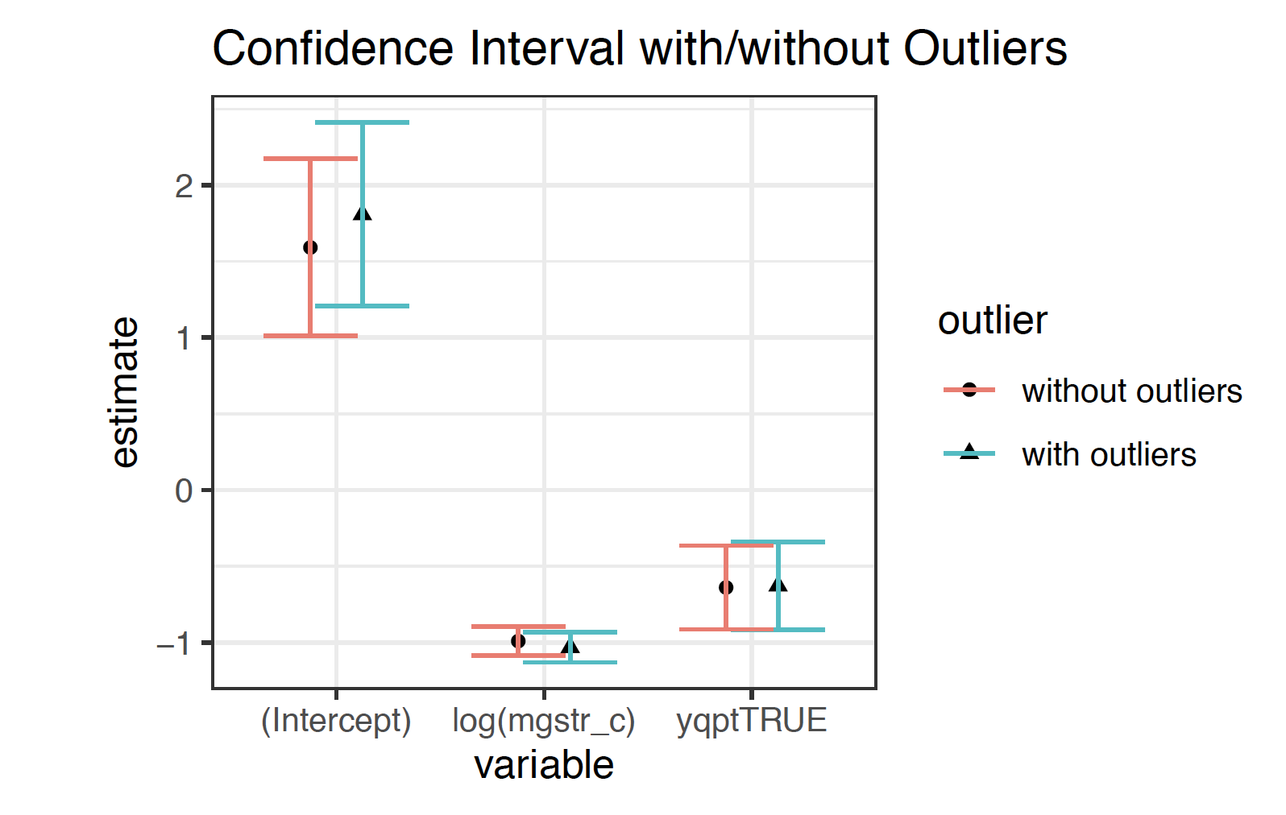
Sensitivity Analysis
Notes:
Figure 8 shows the coefficients confidence intervals are similar, and only the intercept confidence interval are
relatively different. Since we would like to focus on exploring the which factors will significantly affect the
price and make inference based on the majority of data, we exclude the outliers.
Also, compared the two confidence intervals of coefficients as shown in Figure 9, we did not found significant
difference. So we decided to keep the influential points.

Slide 20
Conclusion
Our model is simple and effective. It can be perfectly explained and fit data quite well. It contributes to provide us some insights on the street market of Gabbies.
Our model is quite robust which is not sensitive to influential points and is slightly sensitive to the outliers.
A heavy tailed t distribution on the error term may be an alternative choice if we want to emphasize the tail behavior of the dataset.
Notes:
It is worth noting that our model suggest increasing dosage strength in mg per unit makes negative effect on drug price, which may be explained by the cost-effectiveness from a producer’s aspect. A increase in dosage strength in mg per unit may lead to a smaller size drug per unit, which may have less cost for producer.
After FDA consider Gabapentine as a generic medication in the United States, the supply of Gabapentine increase, leading to a drop of the price . Such policy is effective for the whole country; therefore, it does not show significant heterogeneous effect across distinct states

Slide 21
References
[1] Official website of GoodRx: <https://www.goodrx.com/drug-guide>
[2] Benjamin, D. J., Berger, J. O., Johannesson, M., Nosek, B. A., Wagenmakers, E. J., Berk, R., ... & Cesarini, D.(2018). Redefine statistical significance. Nature Human Behaviour, 2(1), 6.
[3] StreetRx: <https://streetrx.com>

Slide 22
Thanks for listening
Q & A

